Slide 1


#boscoverysat
#tlpinnova
A satellite with homespun electronics
July 2016

Slide 2
INDEX
You are crazy
Problem
Solution
Project Philosophy
Team
Achievements
Tools
Roadmap
Current I+D process

Slide 3
INDEX
You are crazy
Problem
Solution
Project Philosophy
Team
Achievements
Tools
Roadmap
Current I+D process

Slide 4
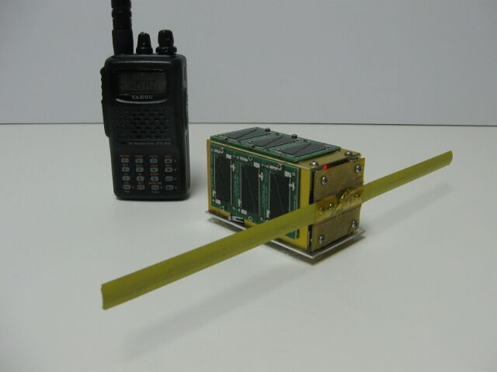
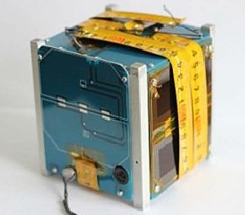
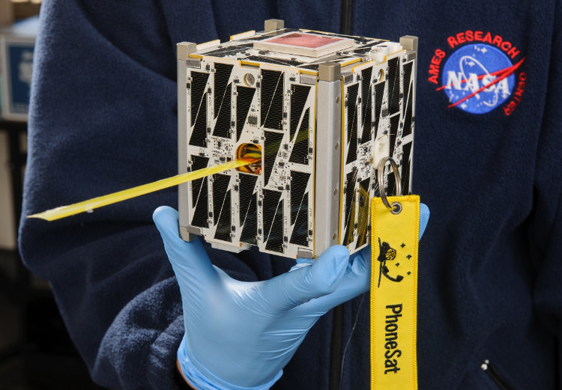
YOU ARE CRAZY
Maybe…
But we are not alone.

Slide 5




YOU ARE CRAZY
50$ Sat
Built by three amateur radio operators.
7 months in orbit.
Dniepper russian rocket.
www.50dollarsat.info

Slide 6
YOU ARE CRAZY
PicoDragon
Built by VNSC
(Vietnam National Satellite Center)
In orbit during 4 months.
ISS
https://vnsc.org.vn/en/projects/profile-of-the-picodragon-satellite/

Slide 7

YOU ARE CRAZY
PhoneSat Series
Built by NASA.
Actually in orbit.
It’s payload is an android phone.
Falcon 9.
phonesat.org

Slide 8
INDEX
You are crazy
Problem
Solution
Project Philosophy
Team
Achievements
Tools
Roadmap
Current I+D process

Slide 9
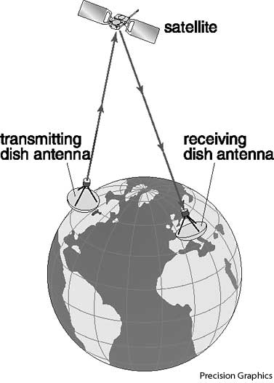
PROBLEM
Classic Satellite Communications
usual problems
High costs
Unaccessible
Private owners
Low bandwidth
Maintenance

Slide 10
INDEX
You are crazy
Problem
Solution
Project Philosophy
Team
Achievements
Tools
Roadmap
Current I+D process

Slide 11
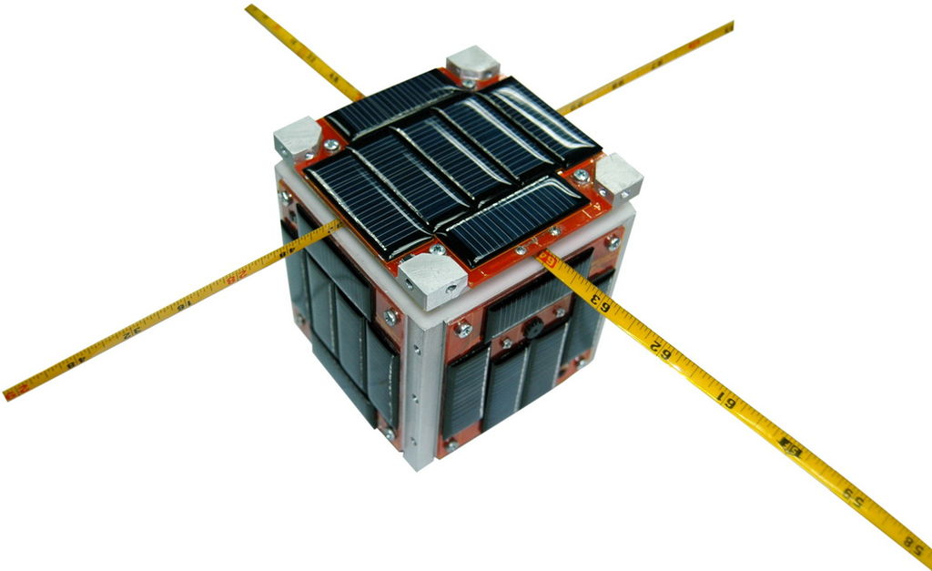
SOLUTION
http://www.cubesat.org/

Slide 12
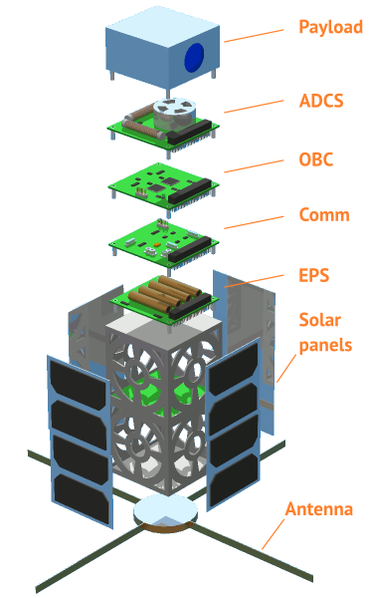
SOLUTION

Slide 13
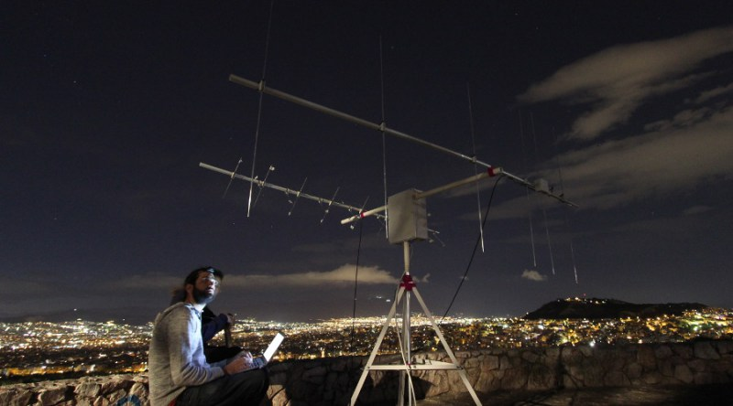
SOLUTION
https://satnogs.org/

Slide 14
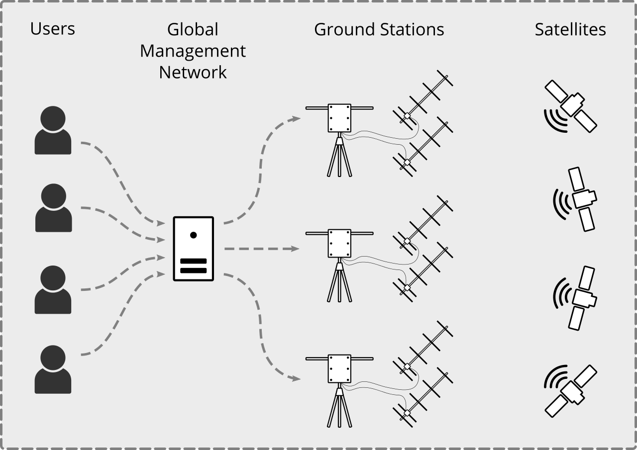

SOLUTION

Slide 15
INDEX
You are crazy
Problem
Solution
Project Philosophy
Team
Achievements
Tools
Roadmap
Current I+D process

Slide 16


PROJECT PHILOSOPHY

Slide 17
INDEX
You are crazy
Problem
Solution
Project Philosophy
Team
Achievements
Tools
Roadmap
Current I+D process

Slide 18
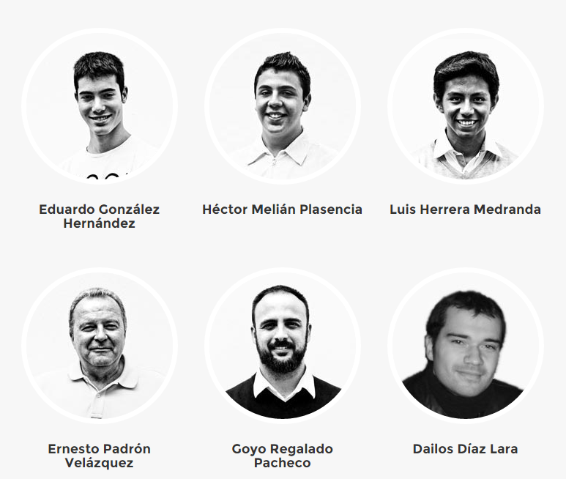
TEAM

Slide 19


TEAM

Slide 20
INDEX
You are crazy
Problem
Solution
Project Philosophy
Team
Achievements
Tools
Roadmap
Current I+D process

Slide 21
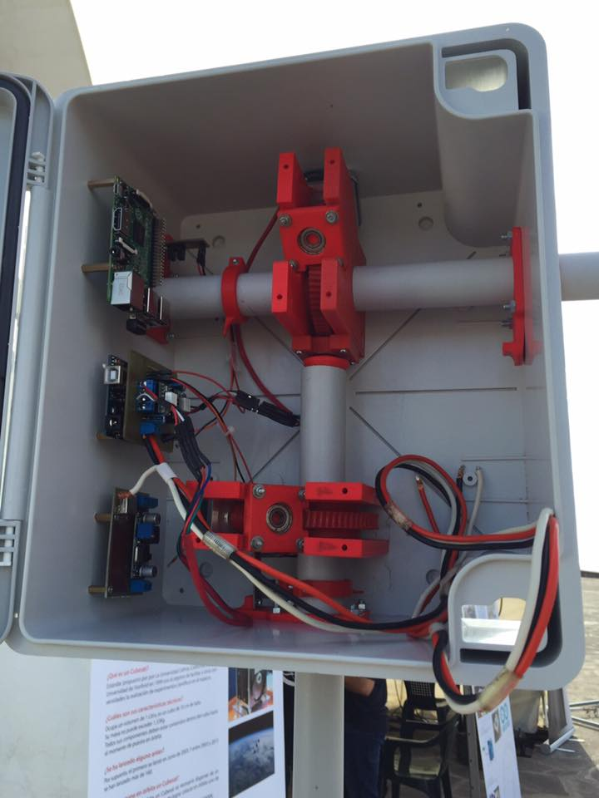
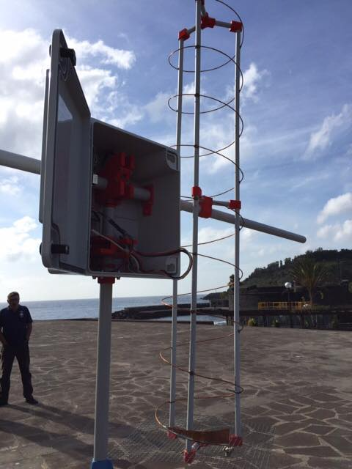
ACHIEVEMENTS
RADIO STATION (SATELLITE TRACKER)

Slide 22
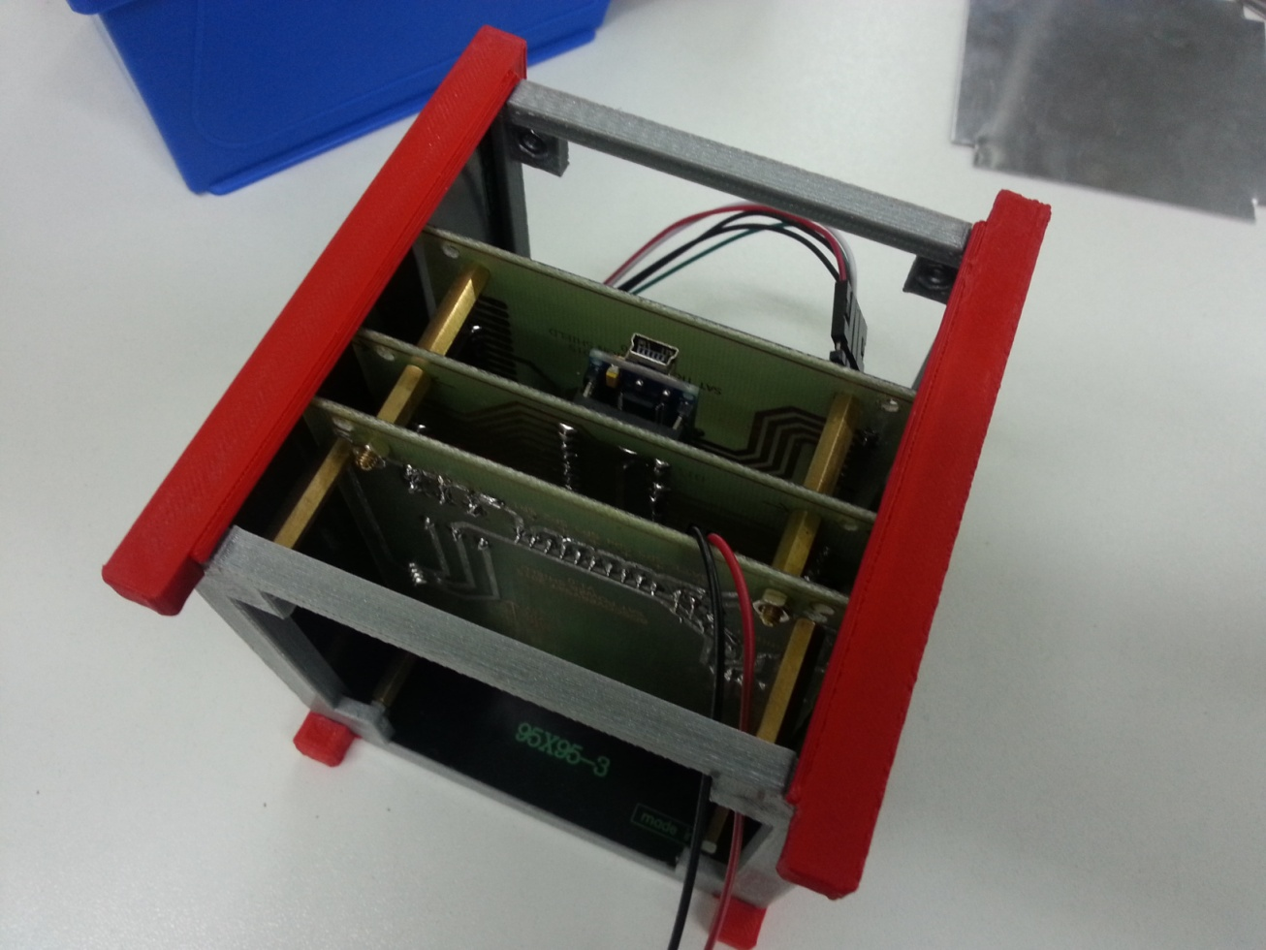
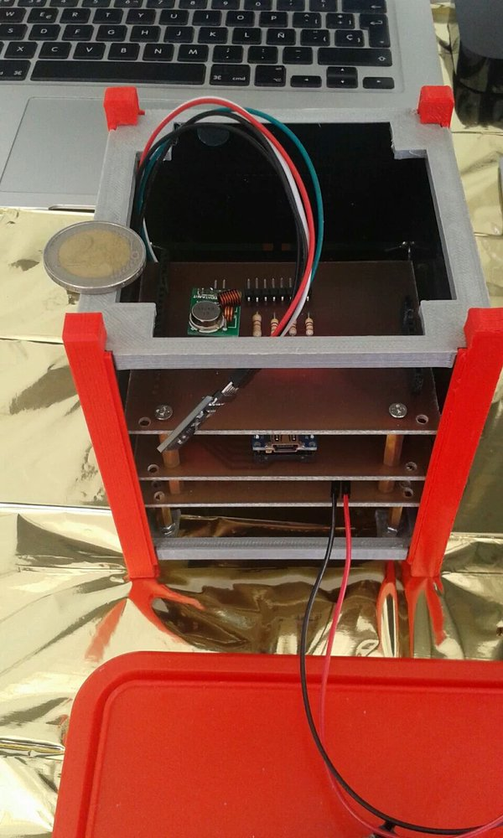
ACHIEVEMENTS
SATELLITE
MARK I – ALPHA 1

Slide 23
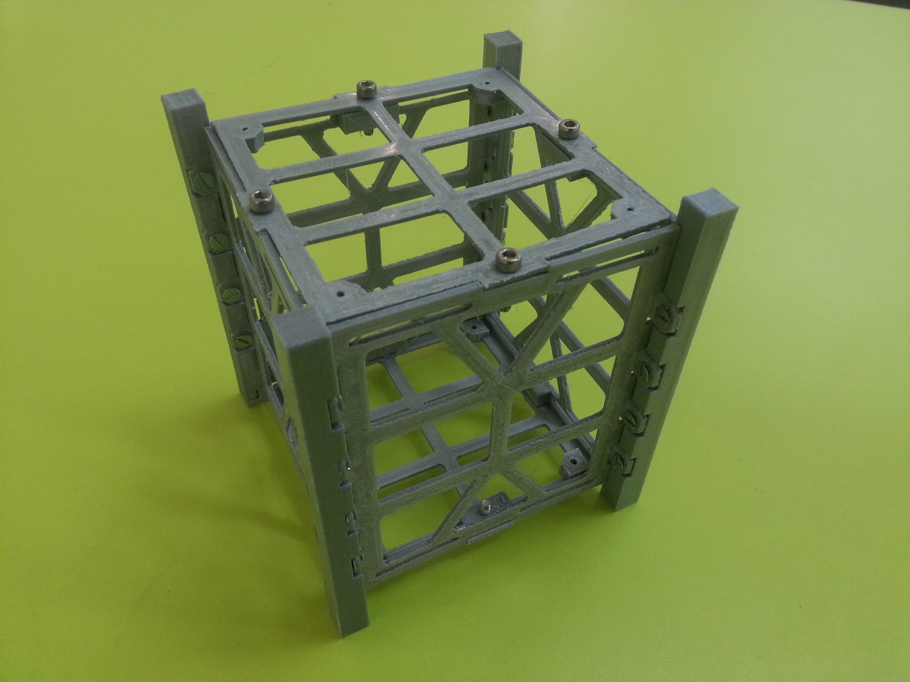
ACHIEVEMENTS
SATELLITE
MARK I – ALPHA 2

Slide 24
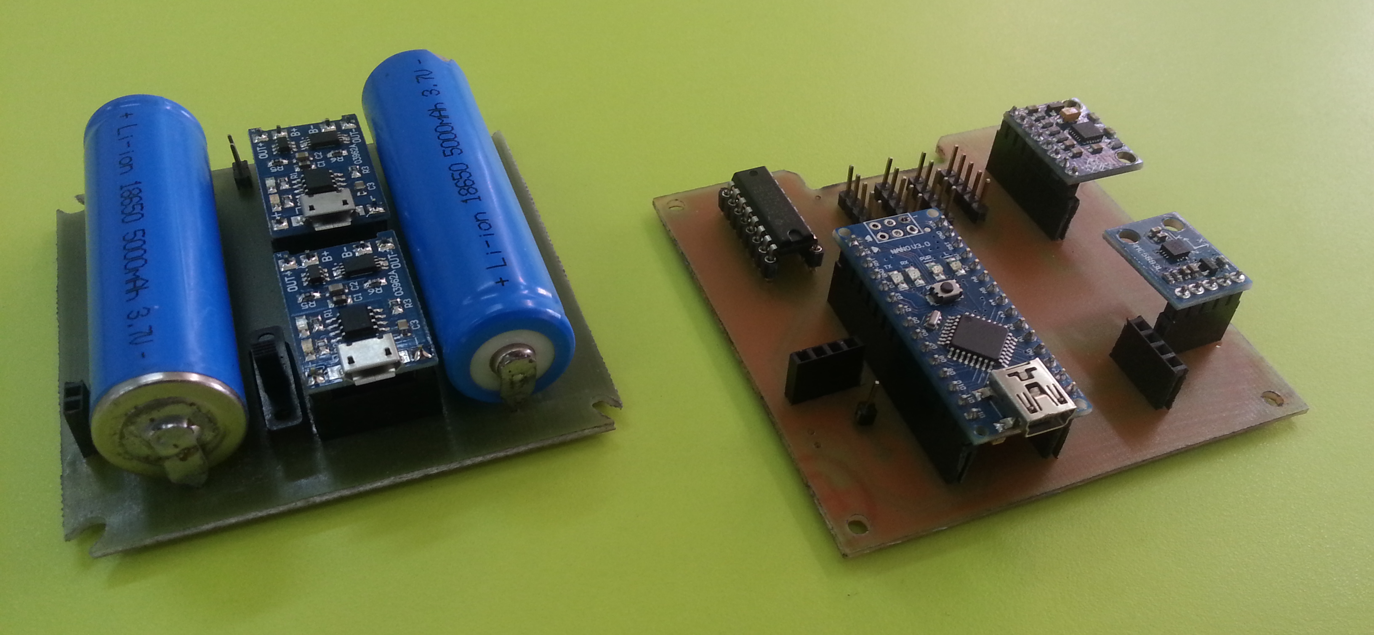
ACHIEVEMENTS
SATELLITE
MARK I – ALPHA 2

Slide 25
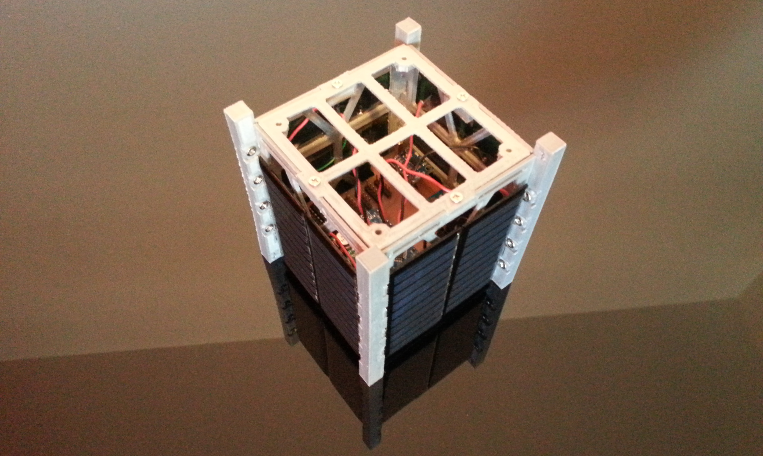
ACHIEVEMENTS
SATELLITE
MARK I – ALPHA 2

Slide 26
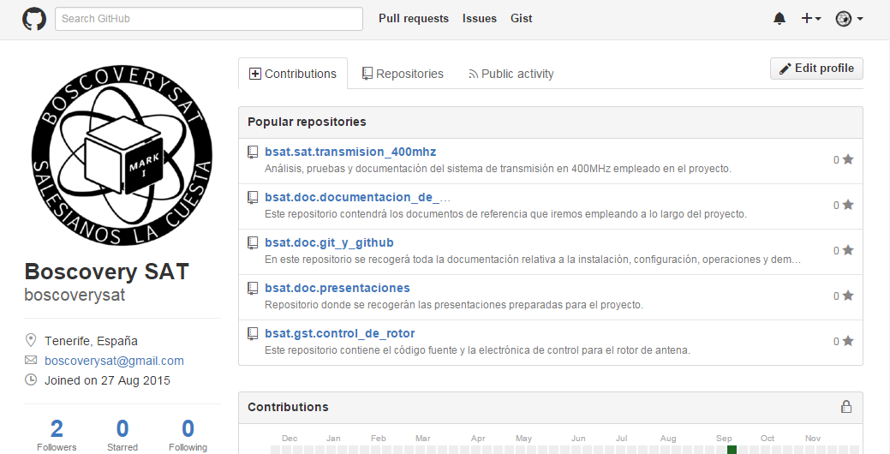
ACHIEVEMENTS
DOCUMENTATION (GitHub Repository)

Slide 27
INDEX
You are crazy
Problem
Solution
Project Philosophy
Team
Achievements
Tools
Roadmap
Current I+D process

Slide 28


TOOLS
COMMUNICATION
Gmail
Whatsapp

Slide 29


TOOLS
TEAMWORK
Google Drive
GitHub

Slide 30


TOOLS
MANAGEMENT
Google Calendar
Trello

Slide 31














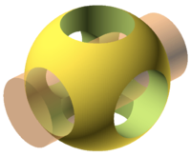

TOOLS
DEVELOPMENT (SW & HW)
Editors and IDEs
Prog. Languages
Version Control
Operative Systems
Satellite & Tracker

Slide 32
INDEX
You are crazy
Problem
Solution
Project Philosophy
Team
Achievements
Tools
Roadmap
Current I+D process

Slide 33
ROADMAP
It is a long time project
Apr
May
Jun
Jul
Aug
Sep
Oct
Nov
Dec
2016
Jan
Dec
2018
2015
2017
Jan
Dec
Jan
Jun

Slide 34
ROADMAP
Apr
May
Jun
Jul
Aug
Sep
Oct
Nov
Dec
2016
Jan
Dec
2018
2015
2017
Jan
Dec
Jan
Jun

Slide 35
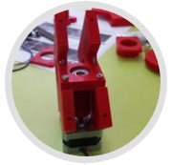
ROADMAP
San Juan Bosco
La Cuesta School
Projects Week 2015
Satellite Tracker
Apr
May
Jun
Jul
Aug
Sep
Oct
Nov
Dec
2016
Jan
Dec
2018
2015
2017
Jan
Dec
Jan
Jun

Slide 36
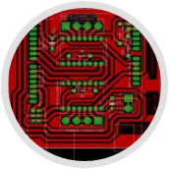
ROADMAP
San Juan Bosco
La Cuesta School
Projects Week 2015
Satellite Tracker
Satellite Tracker
First systems development
Apr
May
Jun
Jul
Aug
Sep
Oct
Nov
Dec
2016
Jan
Dec
2018
2015
2017
Jan
Dec
Jan
Jun

Slide 37
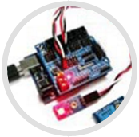
ROADMAP
San Juan Bosco
La Cuesta School
Projects Week 2015
Satellite Tracker
Satellite Tracker
First systems development
Satellite
Orbital sensors testing
Apr
May
Jun
Jul
Aug
Sep
Oct
Nov
Dec
2016
Jan
Dec
2018
2015
2017
Jan
Dec
Jan
Jun

Slide 38
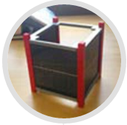
ROADMAP
San Juan Bosco
La Cuesta School
Projects Week 2015
Satellite Tracker
Satellite Tracker
First systems development
Satellite
Orbital sensors testing
Apr
May
Jun
Jul
Aug
Sep
Oct
Nov
Dec
2016
Jan
Dec
2018
2015
2017
Jan
Dec
Jan
Jun
Satellite
Alpha 1 release

Slide 39

ROADMAP
San Juan Bosco
La Cuesta School
Projects Week 2015
Satellite Tracker
Satellite Tracker
First systems development
Satellite
Orbital sensors testing
Apr
May
Jun
Jul
Aug
Sep
Oct
Nov
Dec
2016
Jan
Dec
2018
2015
2017
Jan
Dec
Jan
Jun
Satellite
Alpha 1 released
Phase #1 – Project definition and first developments.
Canary Islands
Science Weeks

Slide 40
ROADMAP
San Juan Bosco
La Cuesta School
Projects Week 2015
Satellite Tracker
Satellite Tracker
First systems development
Satellite
Orbital sensors testing
Apr
May
Jun
Jul
Aug
Sep
Oct
Nov
Dec
2016
Jan
Dec
2018
2015
2017
Jan
Dec
Jan
Jun
Satellite
Alfa 1 release
Phase #1 – Project definition and first developments.
Phase #2 – Payload development and testing.
Canary Islands
Science Weeks

Slide 41
ROADMAP
2016

Slide 42

ROADMAP
Research & Documentation
Jan
Feb
Mar
Apr
May
Jun
Jul
Aug
Sep
Oct
Nov
Dec
2017
Jan
Dec
2016
2018
Jan
Dec
Phase #1 – Project definition and first developments.
Phase #2 – Payload development and testing.

Slide 43

ROADMAP
Research & Documentation
III Science and Technology National Award
St. Louis University Madrid
Jan
Feb
Mar
Apr
May
Jun
Jul
Aug
Sep
Oct
Nov
Dec
2017
Jan
Dec
2016
2018
Jan
Dec
Phase #1 – Project definition and first developments.
Phase #2 – Payload development and testing.

Slide 44
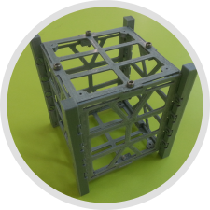
ROADMAP
Research & Documentation
III Science and Technology National Award
St. Louis University Madrid
Structure & Electronics design
3D printed prototype and shields
Jan
Feb
Mar
Apr
May
Jun
Jul
Aug
Sep
Oct
Nov
Dec
2017
Jan
Dec
2016
2018
Jan
Dec
Phase #1 – Project definition and first developments.
Phase #2 – Payload development and testing.

Slide 45
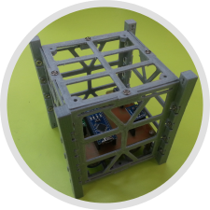
ROADMAP
Research & Documentation
III Science and Technology National Award
St. Louis University Madrid
Structure & Electronics design
3D printed prototype and shields
Jan
Feb
Mar
Apr
May
Jun
Jul
Aug
Sep
Oct
Nov
Dec
2017
Jan
Dec
2016
2018
Jan
Dec
San Juan Bosco
La Cuesta School
Projects Week 2016
Satellite Structure Test
Phase #1 – Project definition and first developments.
Phase #2 – Payload development and testing.

Slide 46
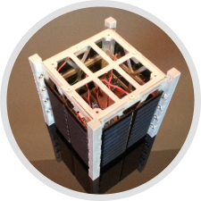
ROADMAP
Research & Documentation
III Science and Technology National Award
St. Louis University Madrid
Structure & Electronics design
3D printed prototype and shields
Jan
Feb
Mar
Apr
May
Jun
Jul
Aug
Sep
Oct
Nov
Dec
2017
Jan
Dec
2016
2018
Jan
Dec
San Juan Bosco
La Cuesta School
Projects Week 2016
Satellite Structure Testing
Phase #1 – Project definition and first developments.
Phase #2 – Payload development and testing.
Satellite
Alpha 2 released

Slide 47
ROADMAP
Research & Documentation
III Science and Technology National Award
St. Louis University Madrid
Structure & Electronics design
3D printed prototype and shields
Jan
Feb
Mar
Apr
May
Jun
Jul
Aug
Sep
Oct
Nov
Dec
2017
Jan
Dec
2016
2018
Jan
Dec
San Juan Bosco
La Cuesta School
Projects Week 2016
Satellite Structure Testing
Phase #1 – Project definition and first developments.
Phase #2 – Payload development and testing.
Satellite
Alpha 2 released
Phase #3 – Official tests and certifications.

Slide 48
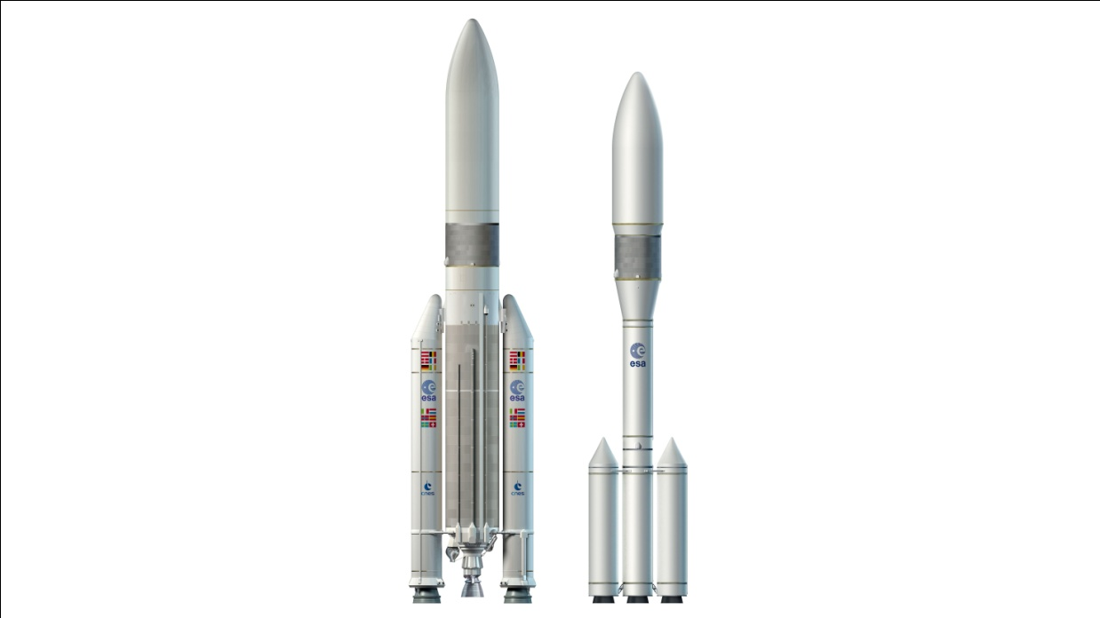
ROADMAP
Research & Documentation
III Science and Technology National Award
St. Louis University Madrid
Structure & Electronics design
3D printed prototype and shields
Jan
Feb
Mar
Apr
May
Jun
Jul
Aug
Sep
Oct
Nov
Dec
2017
Jan
Dec
2016
2018
Jan
Dec
San Juan Bosco
La Cuesta School
Projects Week 2016
Satellite Structure Testing
Phase #1 – Project definition and first developments.
Phase #2 – Payload development and testing.
Satellite
Alpha 2 released
Phase #3 – Official tests and certifications.
Phase #4 – Satellite launching.

Slide 49
INDEX
You are crazy
Problem
Solution
Project Philosophy
Team
Achievements
Tools
Roadmap
Current I+D process

Slide 50
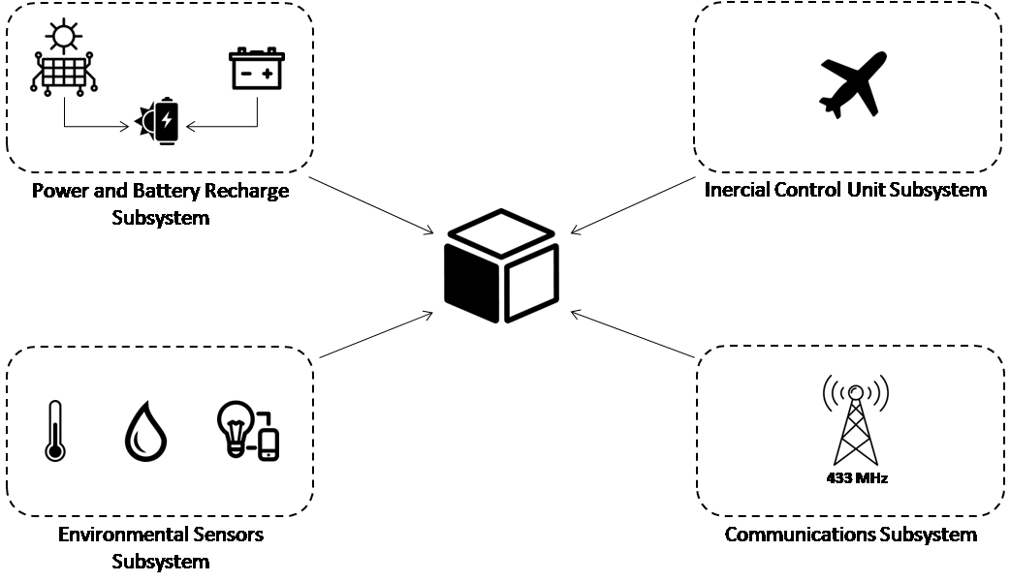
CURRENT I+D PROCESS

Slide 51
CURRENT I+D PROCESS

Slide 52







boscoverysat@gmail.com
@boscoverysat
boscoverysat
boscoverysat.github.com
BoscoverySAT

Slide 53
#boscoverysat
#tlpinnova
A satellite with homespun electronics
July 2016

Slide 54
Satellites' Orbits and Positioning

Slide 55

SATELLITES' ORBITS AND POSITIONING
Based on HEIGHTs
160 km
2.000 km
LOW EARTH ORBIT
(LEO)

Slide 56
SATELLITES' ORBITS AND POSITIONING
Based on HEIGHTs
160 km
2.000 km
LOW EARTH ORBIT
(LEO)
LOW EARTH ORBIT DATA:
Average speed:
7,8km/s (28.080km/h)
Average orbit time:
99 minutes
Usual deployments:
Scientific missions

Slide 57
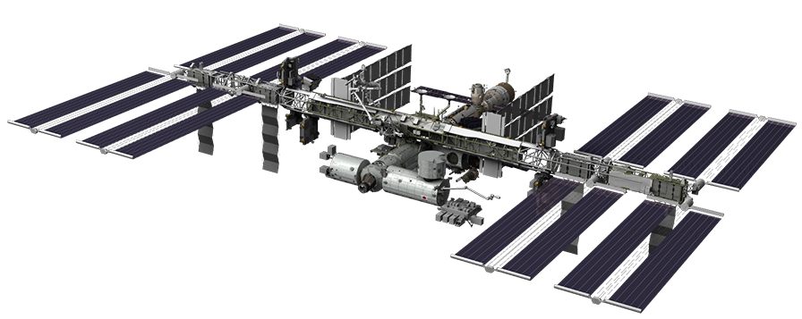
SATELLITES' ORBITS AND POSITIONING
Based on HEIGHTs
Missions deployed at LEO orbit
International Space Station

Slide 58
SATELLITES' ORBITS AND POSITIONING
Based on HEIGHTs
160 km
2.000 km
35.800 km
LEO
MIDDLE EARTH ORBIT
(MEO)

Slide 59
SATELLITES' ORBITS AND POSITIONING
Based on HEIGHTs
160 km
2.000 km
35.800 km
LEO
MIDDLE EARTH ORBIT
(MEO)
MIDDLE EARTH ORBIT DATA:
Average speed:
3,9km/s (14.040km/h)
Average orbit time:
12 - 24 hours
Usual deployments:
GPS (20.200km) and special use for regions tracking

Slide 60
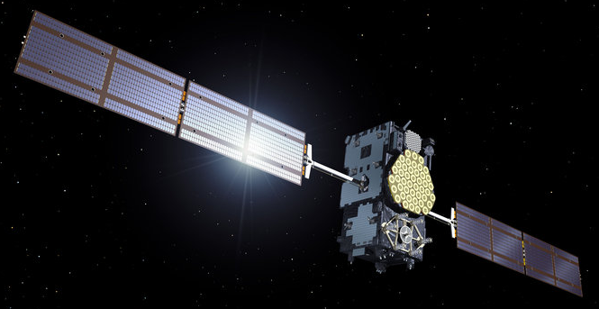
SATELLITES' ORBITS AND POSITIONING
Based on HEIGHTs
Missions deployed at MEO orbit
ESA Galileo GPS Satellite

Slide 61

SATELLITES' ORBITS AND POSITIONING
Based on HEIGHTs
160 km
2.000 km
35.800 km
384.000 km
Moon
LEO
MEO
HIGH EARTH ORBIT
(HEO)
Geosynchronous Orbit

Slide 62
SATELLITES' ORBITS AND POSITIONING
Based on HEIGHTs
160 km
2.000 km
35.800 km
384.000 km
Moon
LEO
MEO
HIGH EARTH ORBIT
(HEO)
Geosynchronous Orbit
MIDDLE EARTH ORBIT DATA:
Average speed:
3,08km/s (11.088km/h) = Earth's rotation speed
Average orbit time:
Years (geostationary orbit)
Usual deployments:
Communications and weather stellites

Slide 63
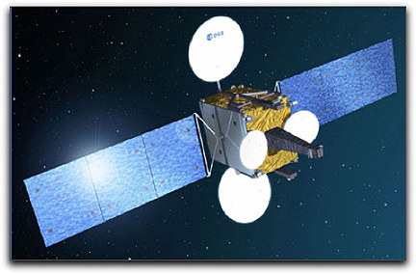
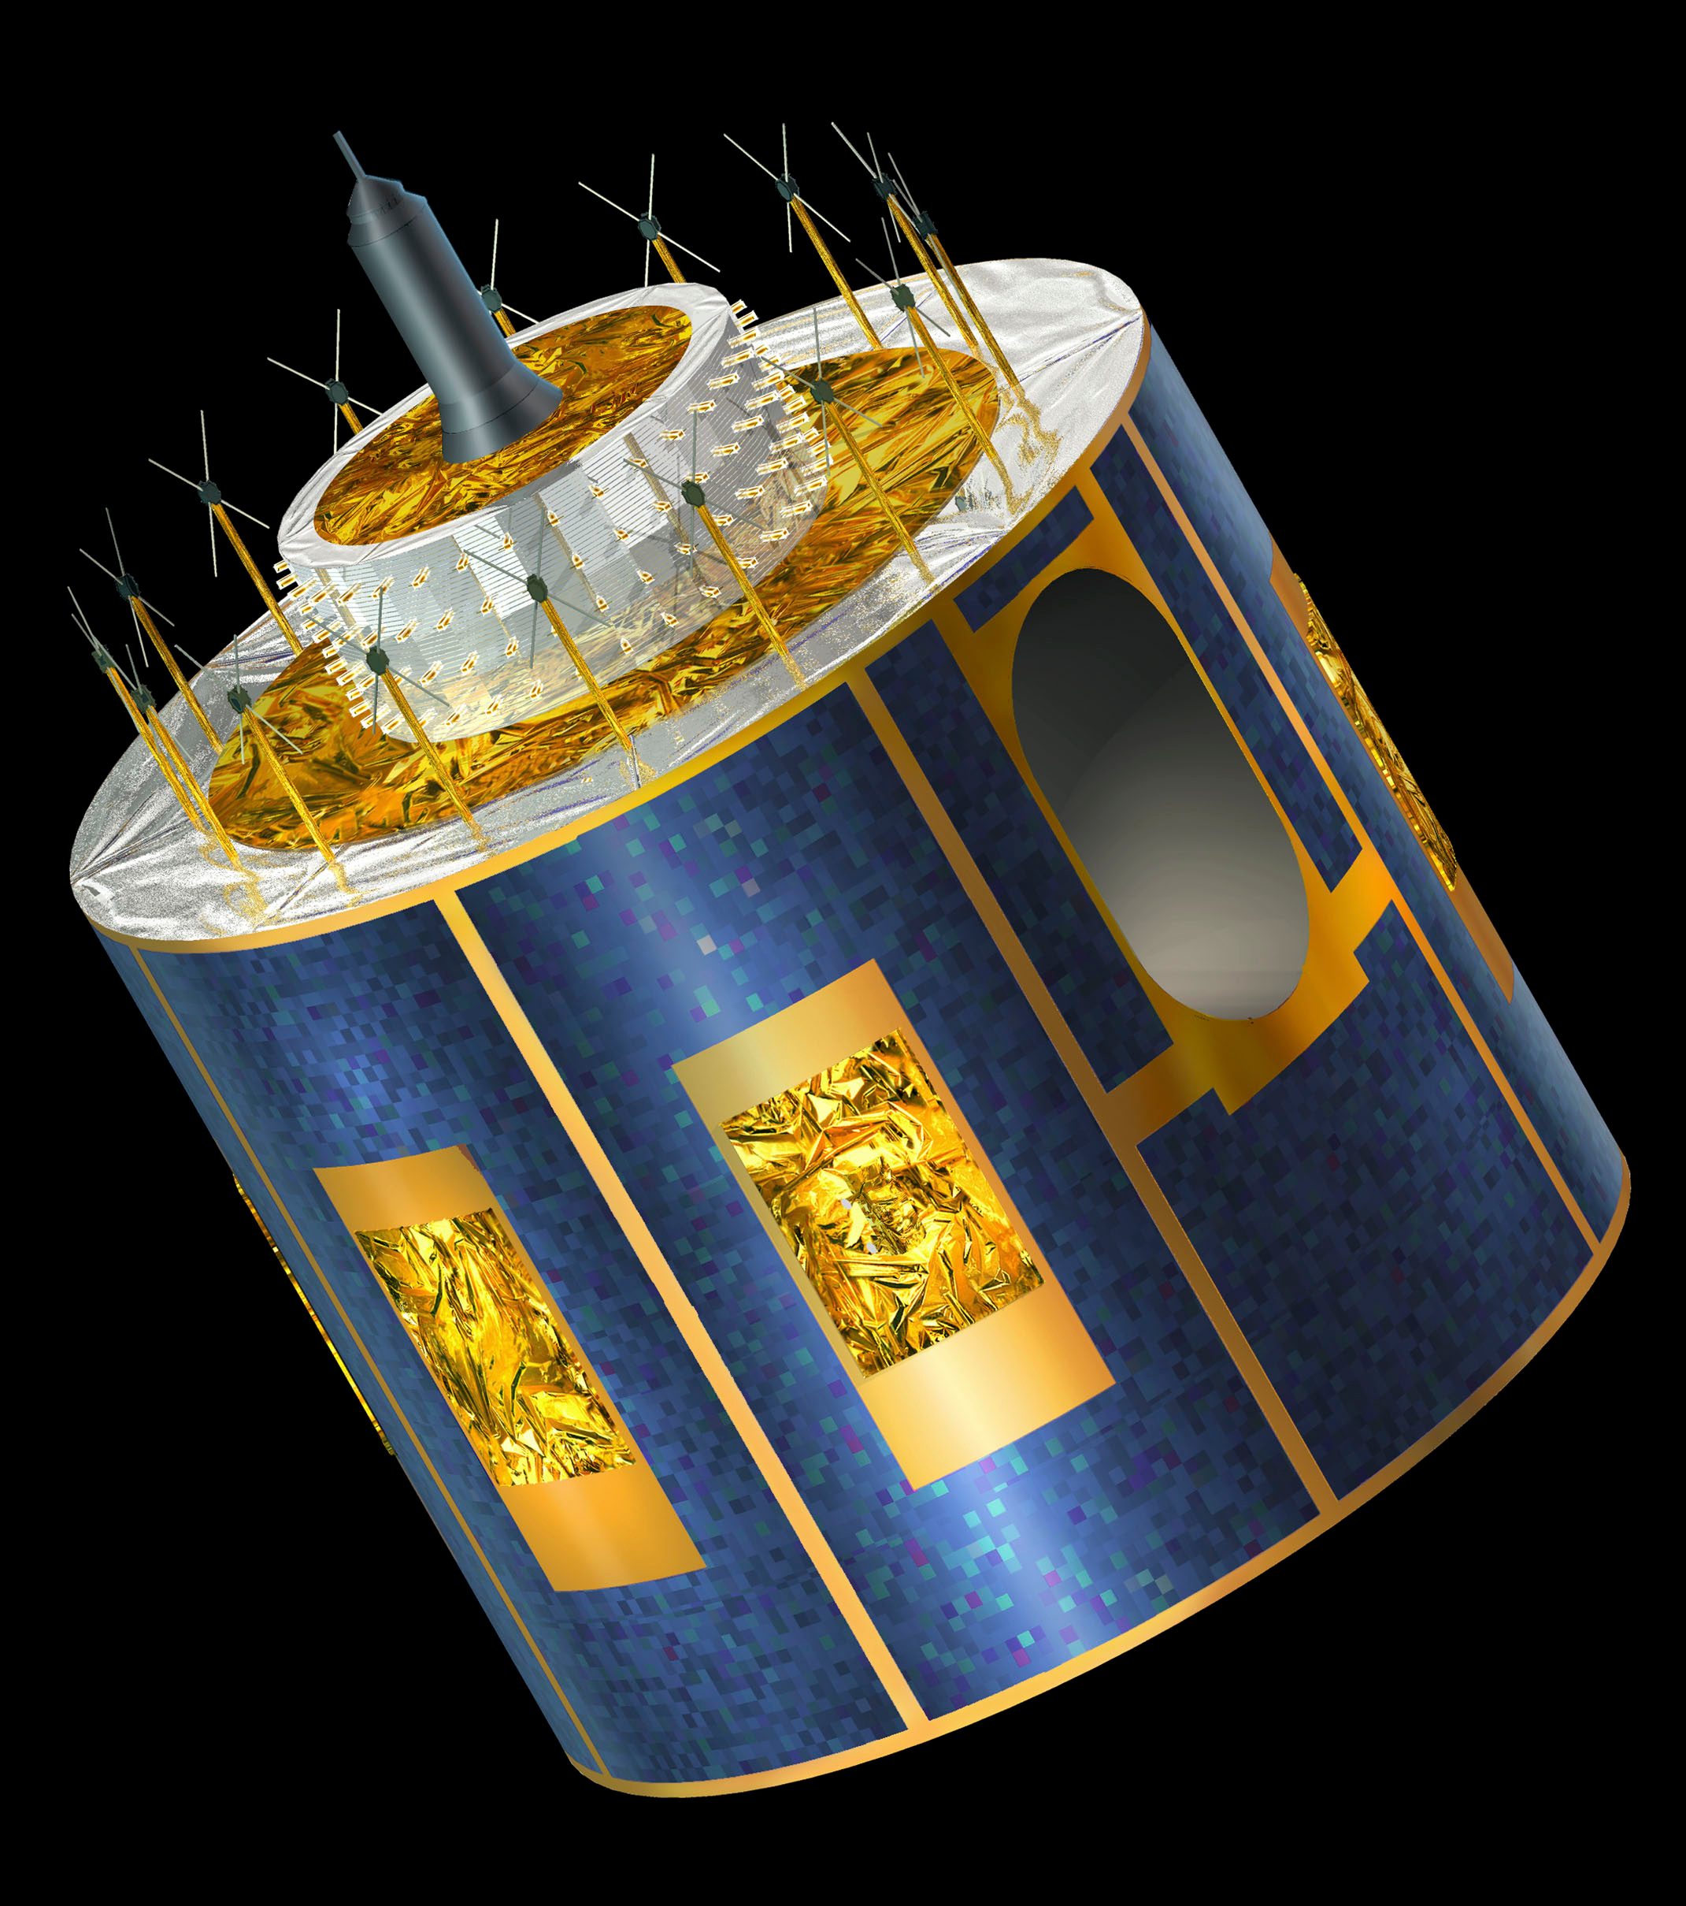
SATELLITES' ORBITS AND POSITIONING
Based on HEIGHTs
Missions deployed at HEO orbit
Hispasat AG1
Meteosat

Slide 64
Power and Battery Recharge Subsystem

Slide 65
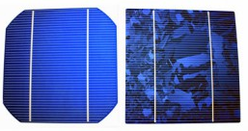
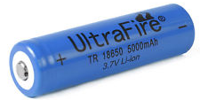
POWER AND BATTERY RECHARGE SUBSYSTEM
Facts
9,5 – 11 VDC/Side
50 – 60mA/Side
2 x 18650 Batt type
3,7V @ 5000mAh

Slide 66
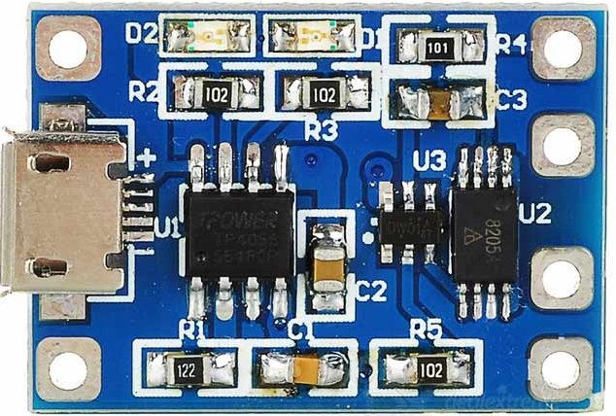
POWER AND BATTERY RECHARGE SUBSYSTEM
Facts
Fails
9,5 – 11 VDC/Side
50 – 60mA/Side
2 x TP4056
4,1V @ 1A
Battery Charger
2 x 18650 Batt type
3,7V @ 5000mAh

Slide 67
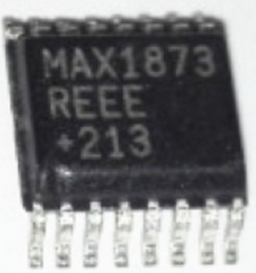
POWER AND BATTERY RECHARGE SUBSYSTEM
Facts
Fails
Researching
9,5 – 11 VDC/Side
50 – 60mA/Side
2 x TP4056
4,1V @ 1A
Battery Charger
MAX1873REEE
Up to 4 Li+ Batts
-40ºC to +85ºC
2 x 18650 Batt type
3,7V @ 5000mAh

Slide 68
Environmental Sensors Subsystem

Slide 69
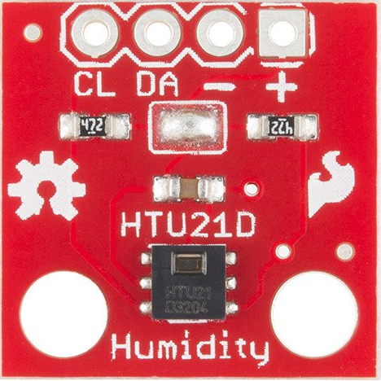
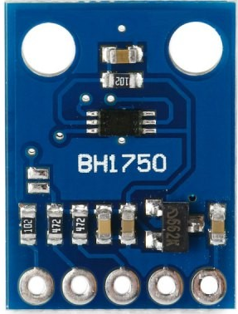
ENVIRONMENTAL SENSORS SUBSYSTEM
Facts
HTU21D
Temperature
Battery, Cockpit, Side 1 – 6, Control Unit
BH1750L
Light Intensity
Side 1 – 6

Slide 70
ENVIRONMENTAL SENSORS SUBSYSTEM
Facts
Issues
HTU21D
Temperature
Multiple I2C devices with the same address.
Battery, Cockpit, Side 1 – 6, Control Unit
BH1750L
Light Intensity
Side 1 – 6

Slide 71
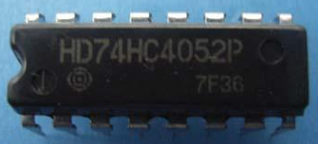
ENVIRONMENTAL SENSORS SUBSYSTEM
Facts
Issues
HTU21D
Temperature
Multiple I2C devices with the same address.
Battery, Cockpit, Side 1 – 6, Control Unit
Researching
Multiplexing SDA wire.
BH1750L
Light Intensity
Side 1 – 6
Dual CMOS 4-channel analog
multiplexer, demultiplexer.

Slide 72
Communications Subsystem

Slide 73
COMMUNICATIONS SUBSYSTEM
Facts
Telemetry & Configuration
UHF 430 – 440 MHz
Radio Communication
VHF 144 – 148 MHz

Slide 74
COMMUNICATIONS SUBSYSTEM
Facts
Issues
Telemetry & Configuration
Buffer overflow on packages transmission for telemetry and configuration.
UHF 430 – 440 MHz
Radio Communication
VHF 144 – 148 MHz

Slide 75
COMMUNICATIONS SUBSYSTEM
Facts
Issues
Telemetry & Configuration
Buffer overflow on packages transmission for telemetry and configuration.
UHF 430 – 440 MHz
Researching
Radio Communication
Error control by parity bits.
VHF 144 – 148 MHz
Antenna deploymen system.

Slide 76
Budget

Slide 77




TOTAL RESOURCES INVESTED UP TODAY
Electronics
190,00 €
3D Printing
75,00 €
Mechanical components
25,00 €
Other materials
30,00 €
TOTAL AMOUNT
220,00 €
Total spent time (aprox.)
1.490 h

Slide 78



DEPLOYMENT BUDGET
500,00 €
10.000,00 €
60.000,00 €
Unexpected expenses
2.500,00 €
TOTAL AMOUNT
73.000,00 €

Slide 79
Real deployed CubSat based projects on

Slide 80
REAL DEPLOYED CUBSAT BASED PROJECTS ON
Test text

Slide 81
#boscoverysat
#tlpinnova
A satellite with homespun electronics
July 2016

